Slide 1
Code Kata battle project
Authors:
Matteo Sissa
Sara Zappia
Alessandro Saccone
Reference professor:
Prof. Matteo Camilli

Slide 2
Outline
Goals
Functional Requirements
Major Use Cases
Architecture
Patterns
Unit and Integration Testing
Demo

Slide 3
Goals
The system allows students to practice and improve their coding skills by developing solutions to code kata battles.
The system provides to educators a platform to publish code kata battles and easily manage tournaments and battles for students.
The system makes the task of coding battles’ solutions as fun as possible, introducing elements like competitiveness, rankings, teamwork and badges (or rewards).

Slide 4
FUNCTIONAL REQUIREMENTS
The system should allow students and educators to log in the platform using their GitHub account
Educators can create tournaments and battles, and students to subscribe to them
The system should notify students when a new tournament is created on the CKB platform and when it is closed
The system manages all the interactions with the GitHub platform to allow students to submit their code solutions through GitHub

Slide 5
MAJOR USE CASES
Highlight the most relevant use cases of the software application to show its major functionalities.

Slide 6
Use cases outline
UC1 & UC2
Login and registration of users
UC3 & UC4
Creation of tournament and battle
UC6 & UC7 & UC8
Subscribe to a tournament and to a battle
UC9 & UC10 & UC11
GitHub interaction

Slide 7
ARCHITECTURE
Microservices
Three-tier Web Application
Event-Driven Architecture
Shared Database

Slide 8
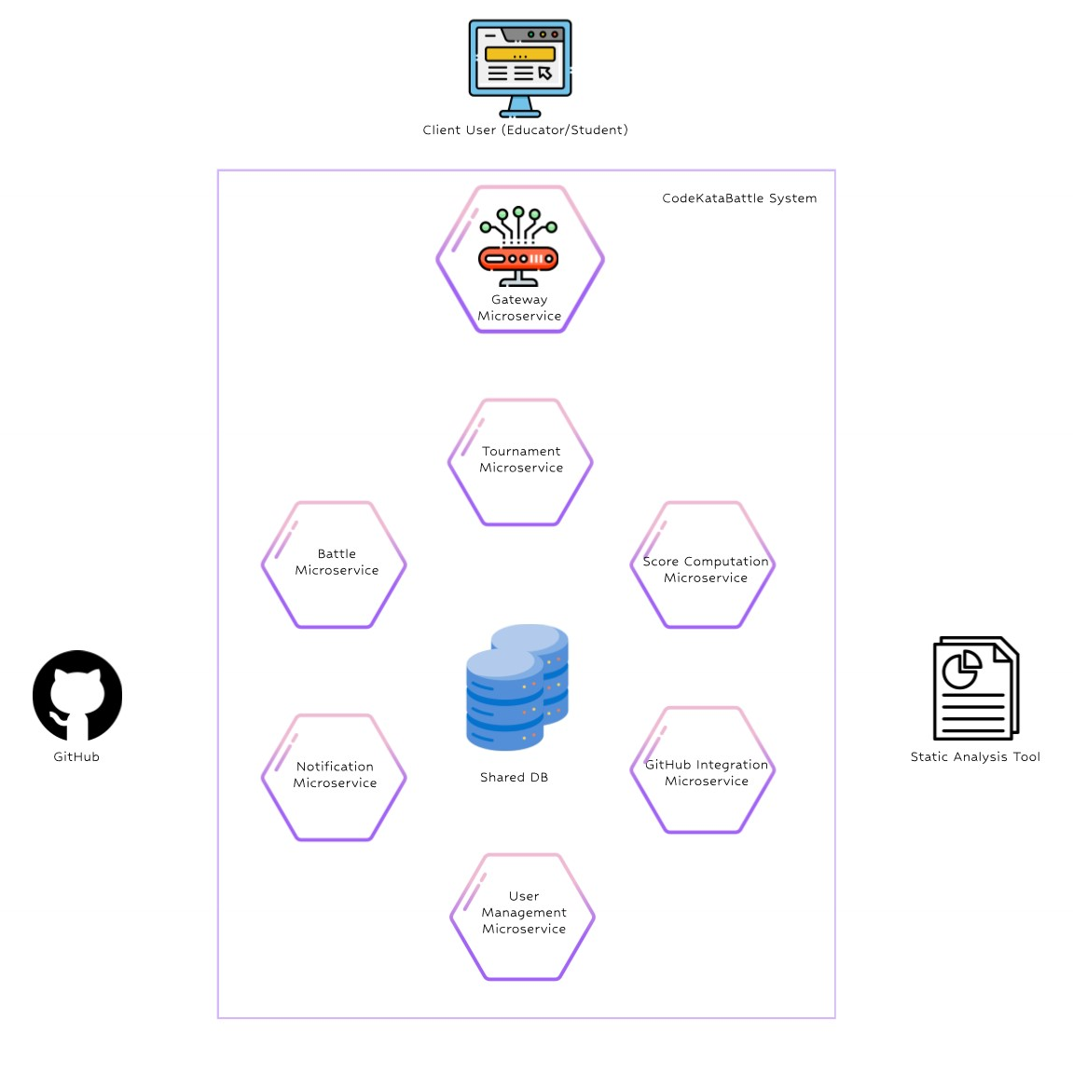

Slide 9
PATTERNS
Restful APIs
Model-View-Controller pattern

Slide 10
IMPLEMENTATION
Java language
Spring Boot Framework & Java Persistence API
PostgreSQL
Apache Kafka
SonarQube
GitHub API

Slide 11
UNIT TESTING
JUnit5
Mockito Framework
INTEGRATION TESTING
Testing Isolation
WireMock Framework
private WireMockServer wireMockServer;
wireMockServer = new WireMockServer(WireMockConfiguration .options()
.usingFilesUnderDirectory("github_integration_microservice/src/test/resources")); wireMockServer.start();

Slide 12
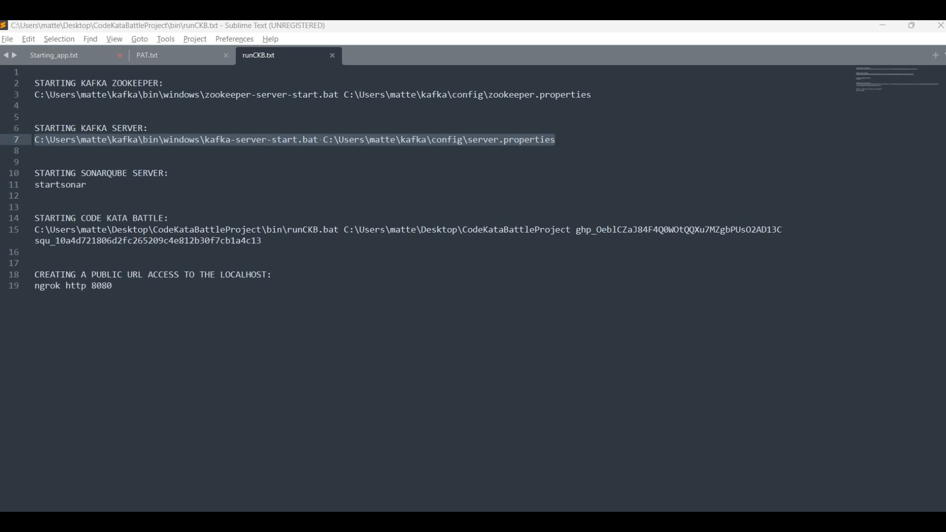
Starting the CKB application

Slide 13
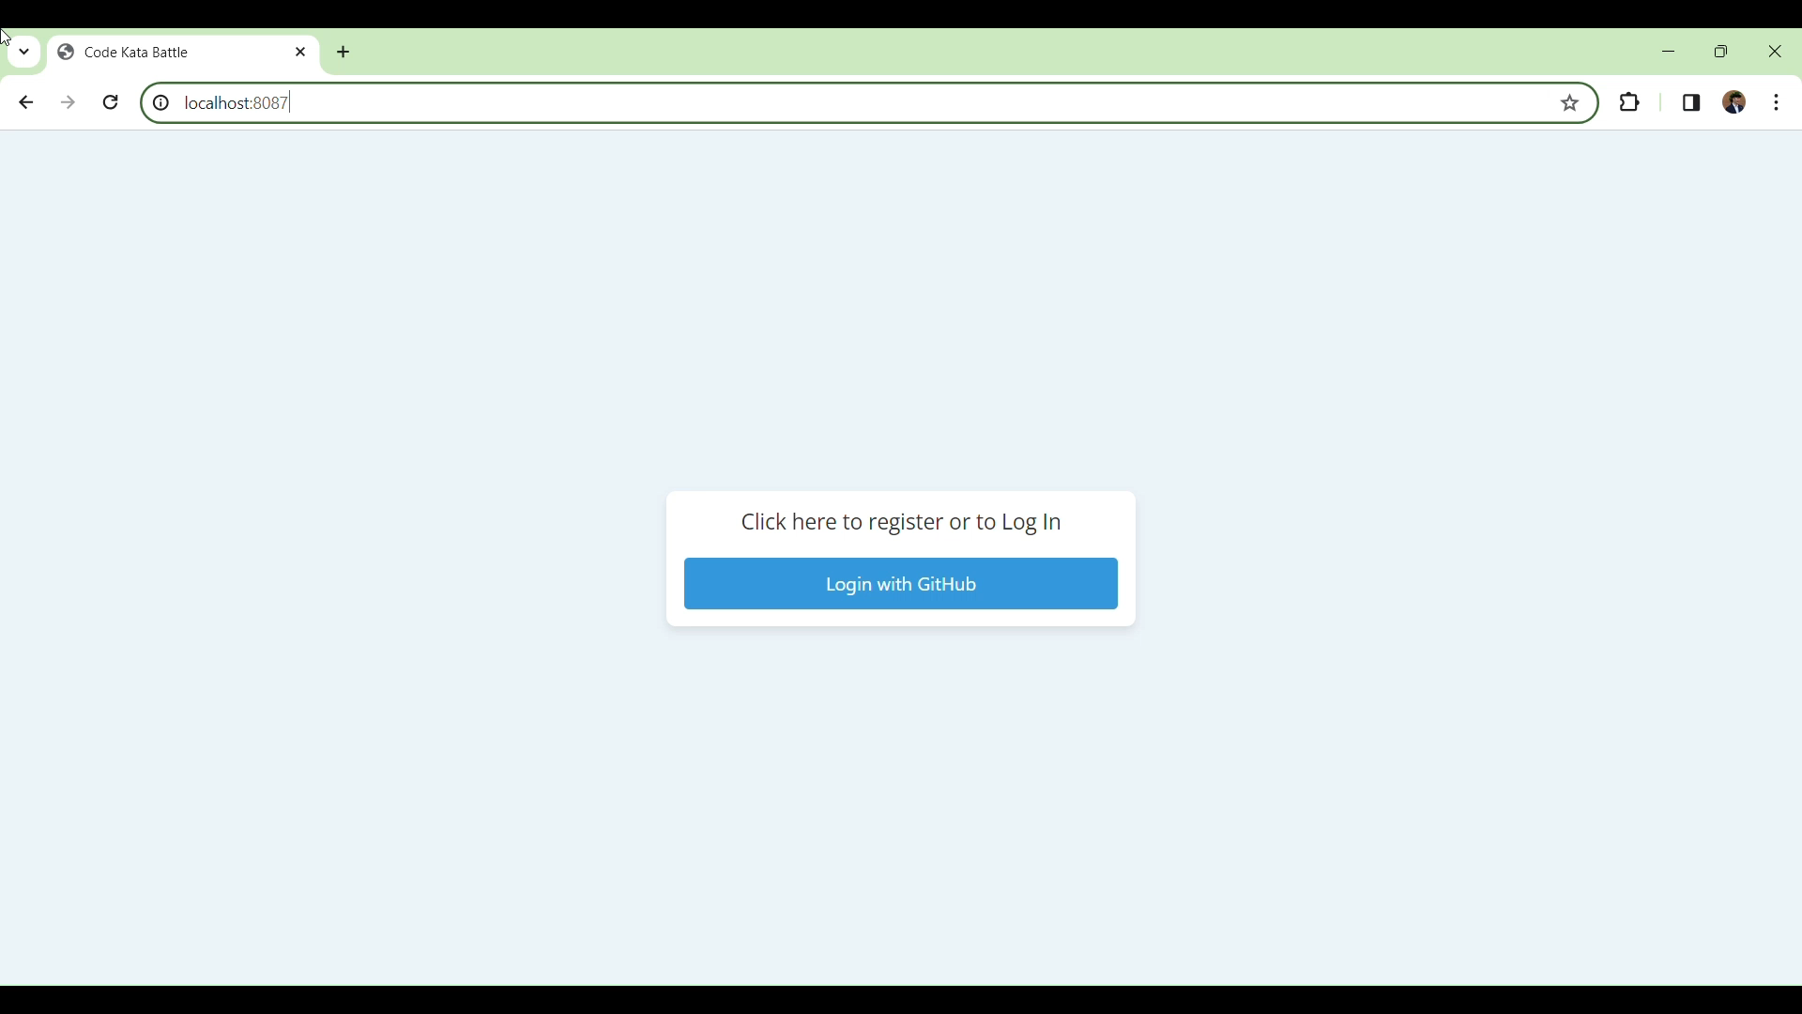
REGISTER AS A STUDENT

Slide 14
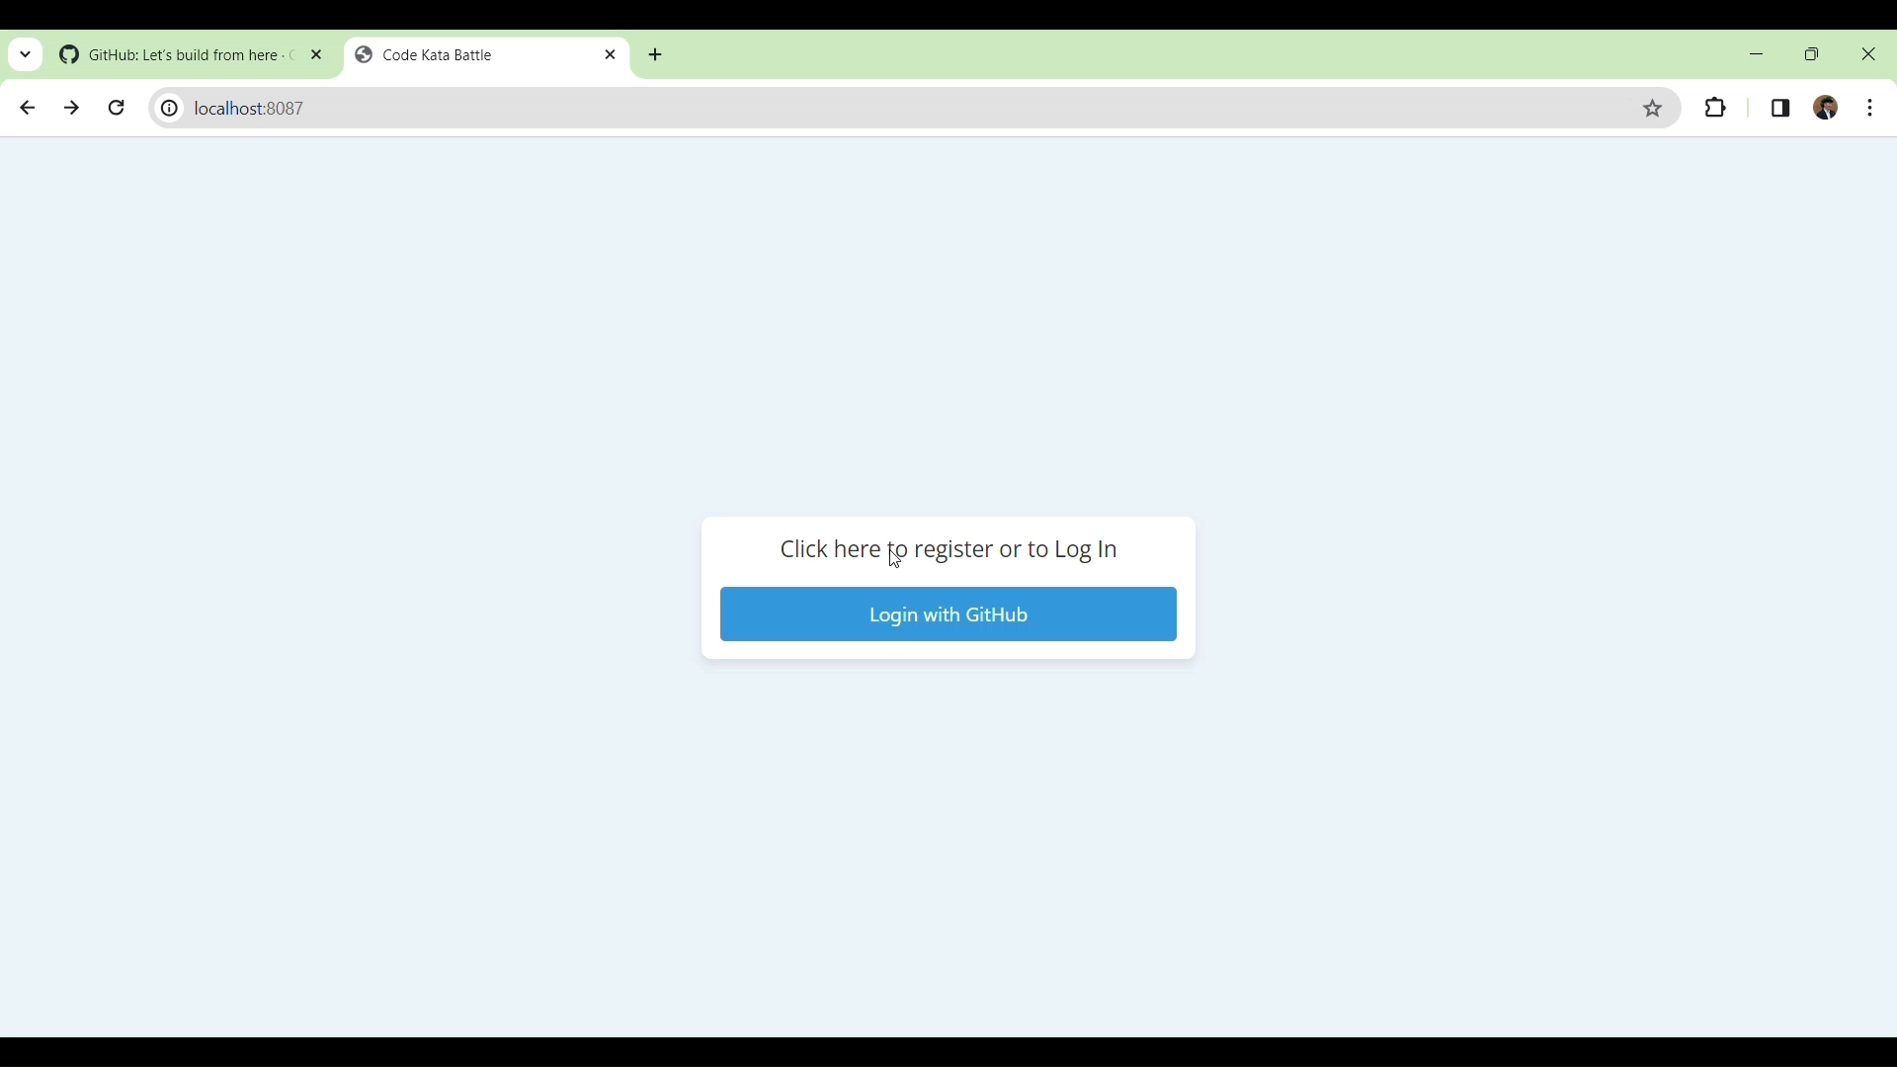
REGISTRATION EDUCATOR CREATION TOURNAMENT AND BATTLE

Slide 15
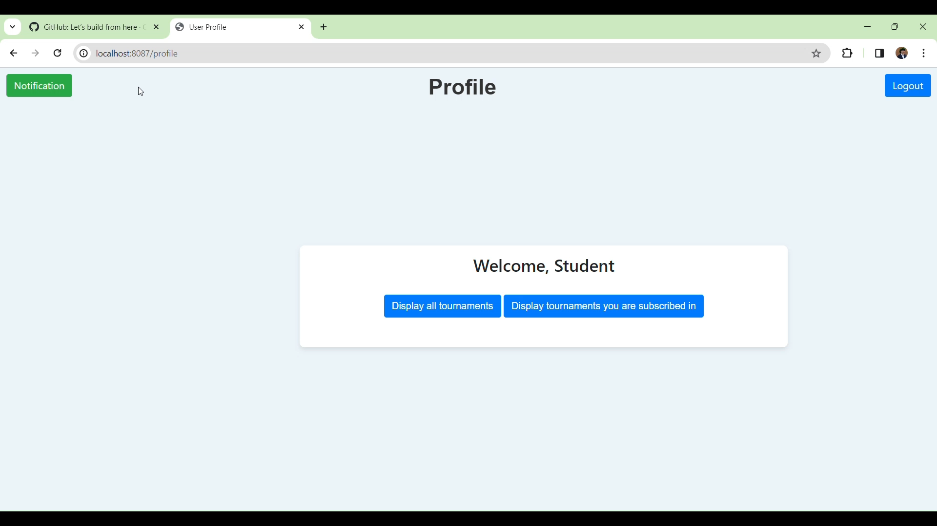
SUBSCRIPTION STUDENT TO TOURNAMENT AND BATTLE

Slide 16
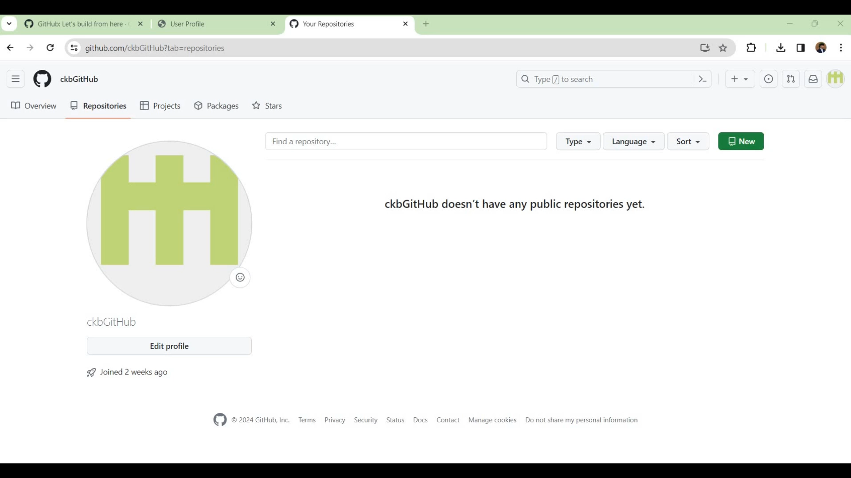
CREATE GITHUB REPOSITORY

Slide 17
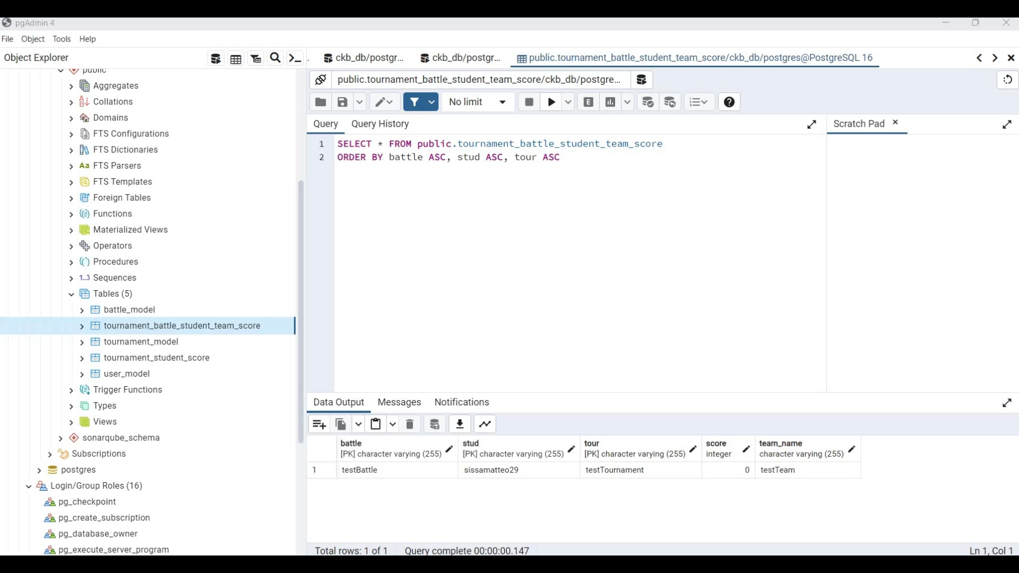
Push code github score computation

Slide 18
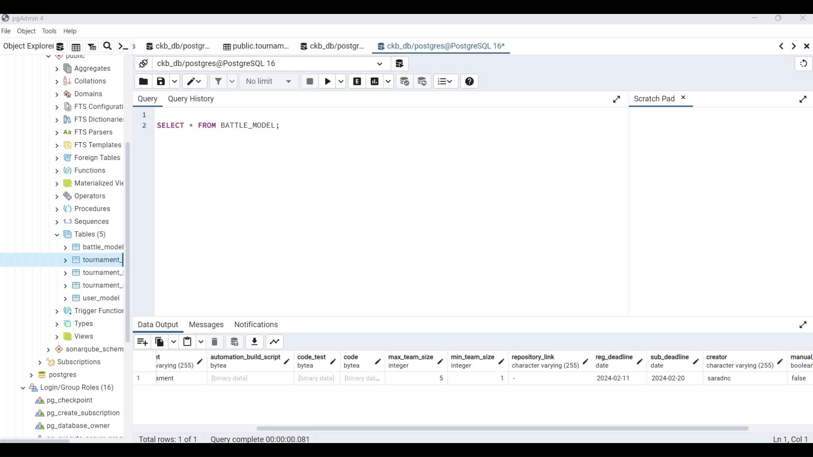
END OF BATTLE UPDATE TOURNAMENT SCORE

Slide 19
THANKS FOR THE ATTENTION

